Slide 1

Advance DRIVING SCHOOL MANAGEMENT SYSTEM
GROUP-1

Slide 2
TEAM MEMBERS
ID | NAME
2498438 | Aishwarya G
2498769 | Mule Vaibhav
2498745 | ATLA Siddishwaramma
2498463 | Martha Shivalika
2498461 | Mohamedaslam O M
2498177 | UTTEJ AWASTHI
2498891 | Guntur Gopiraj
2498791 | Chimala Purna Chandra Rao
2498779 | Moulaali Ikbal Hujare
2498032 | Sarbojit Singha Roy

Slide 3
INDEX
Introduction
Project Scope
Tools & Technologies
ER Diagram
Schema
Admin Module
Student Module
Output
Conclusion

Slide 4
INTRODUCTION
This Advanced Driving School Management system can reduce the efforts of human power and wealth very much and ensure driving-training school’s information resource to be utilized effectively.
It is a web-based application for maintaining records of car and training school. It will maintain the record of entire students at driving school.
This application automates manual tasks by managing all records of student’s admission, Attendance,vehicles,and trainers.

Slide 5
PROJECT SCOPE
This Advanced Driving School Management system can reduce the efforts of human power.
It will maintain the record of entire students at driving school.
This application automates manual tasks by managing all records.
It is a web-based application for maintaining records.

Slide 6
TECHNOLOGIES
Front end: Angular
Server Side: Spring Boot
Back-end: Hibernate , MY SQL
Server: Tomcat 9.0

Slide 7

Register into portal
Login into portal
Manage Records
Admin
Maintain Records
Student
view the portal
select trainers

Slide 8
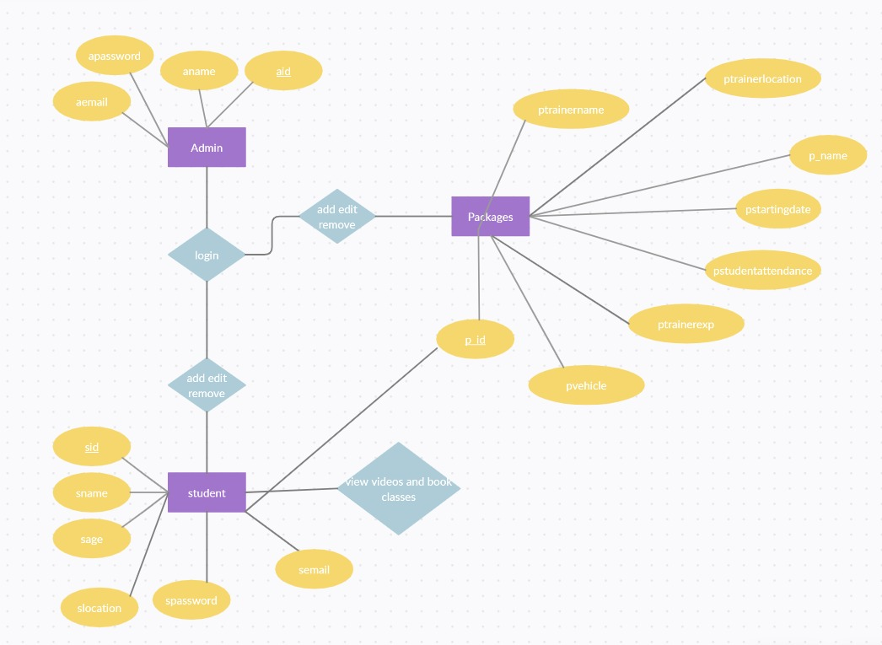
ER DIAGRAM

Slide 9
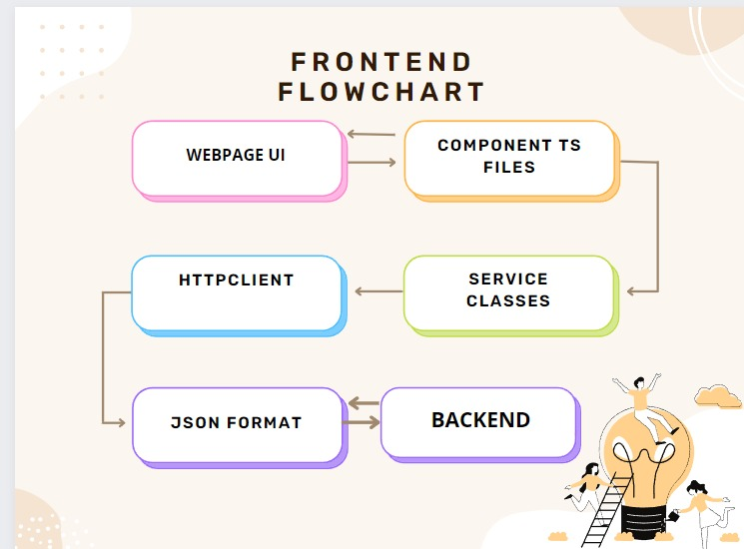

Slide 10
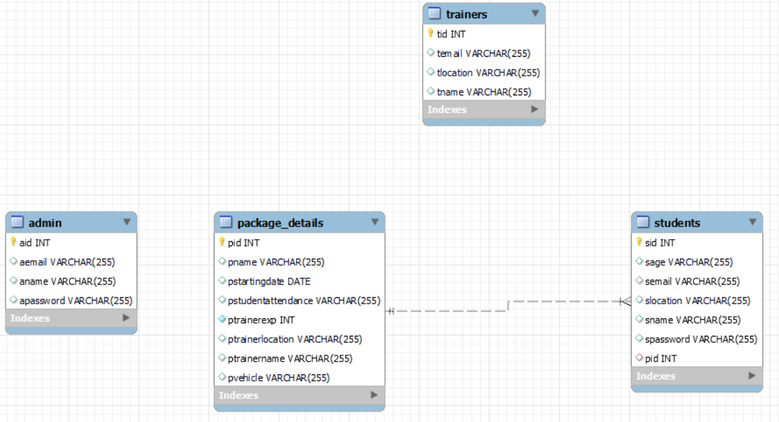
SCHEMA

Slide 11
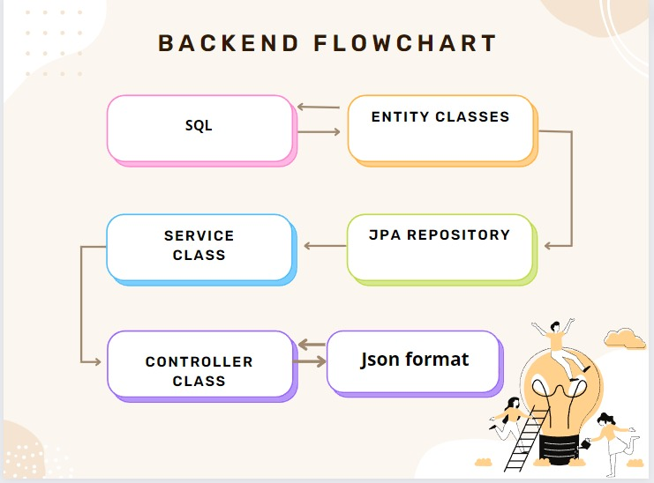
FLOW DIAGRAM:

Slide 12
SYSTEM OVERVIEW
The “Driving School Management” should support basic functionalities for all below listed users.
Administrator
Students
Authentication & Authorization:-
Authentication: Any end-user should be authenticated using a unique user-id and password.
Authorization: The operations supported and allowed would be based on the user type.

Slide 13
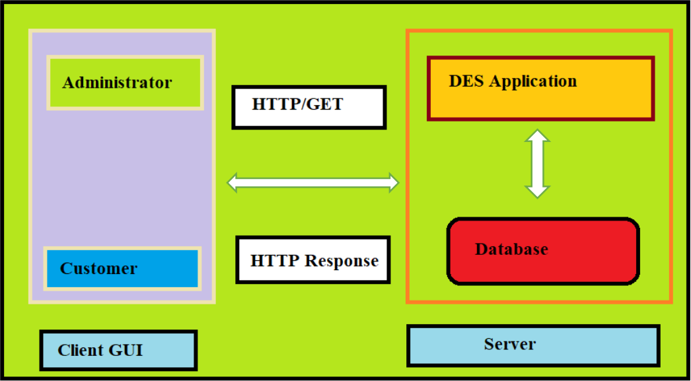
FUNCTIONAL FLOW
The functional flow of the messages across different application components is shown below. Ex. - Web Application.
Application
Student

Slide 14
FUNCTIONAL SPECIFICATIONS
Login | Logout:-
[Web Application - MySQL, Spring-boot, Angular]
Go to Registration screen when you click on Register link.
Go to Success screen when you login successfully after entering valid username & password fetched from the database.
Redirect back to same login screen if username & password are not matching.
Implement Session tracking for all logged in users before allowing access to application features. Anonymous users should be checked, unless explicitly mentioned.

Slide 15
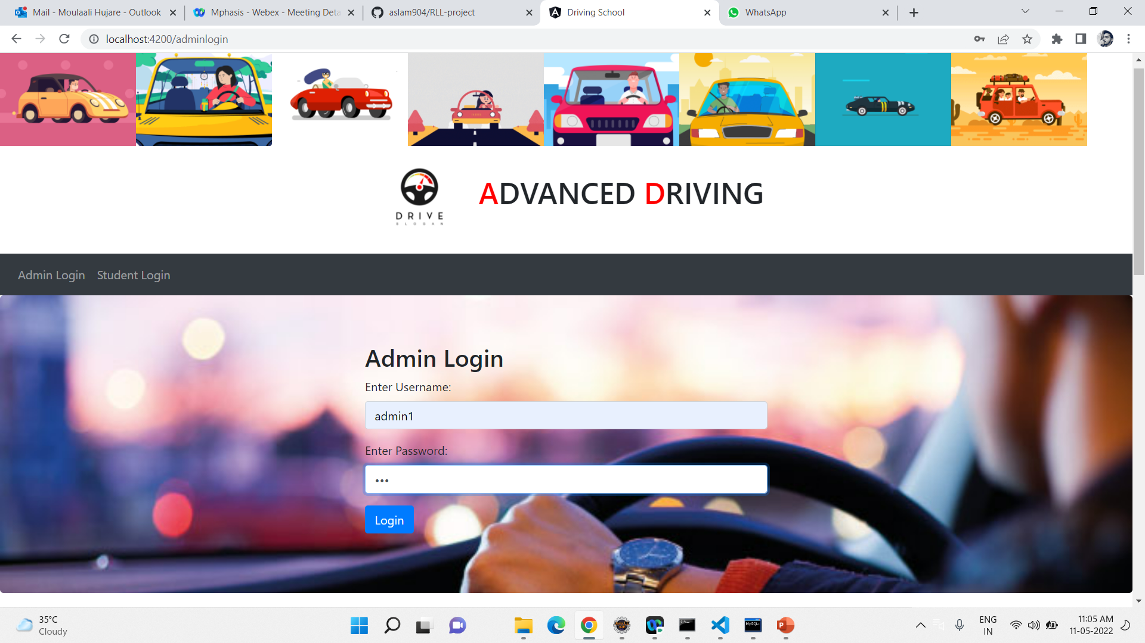
Admin Login Page

Slide 16
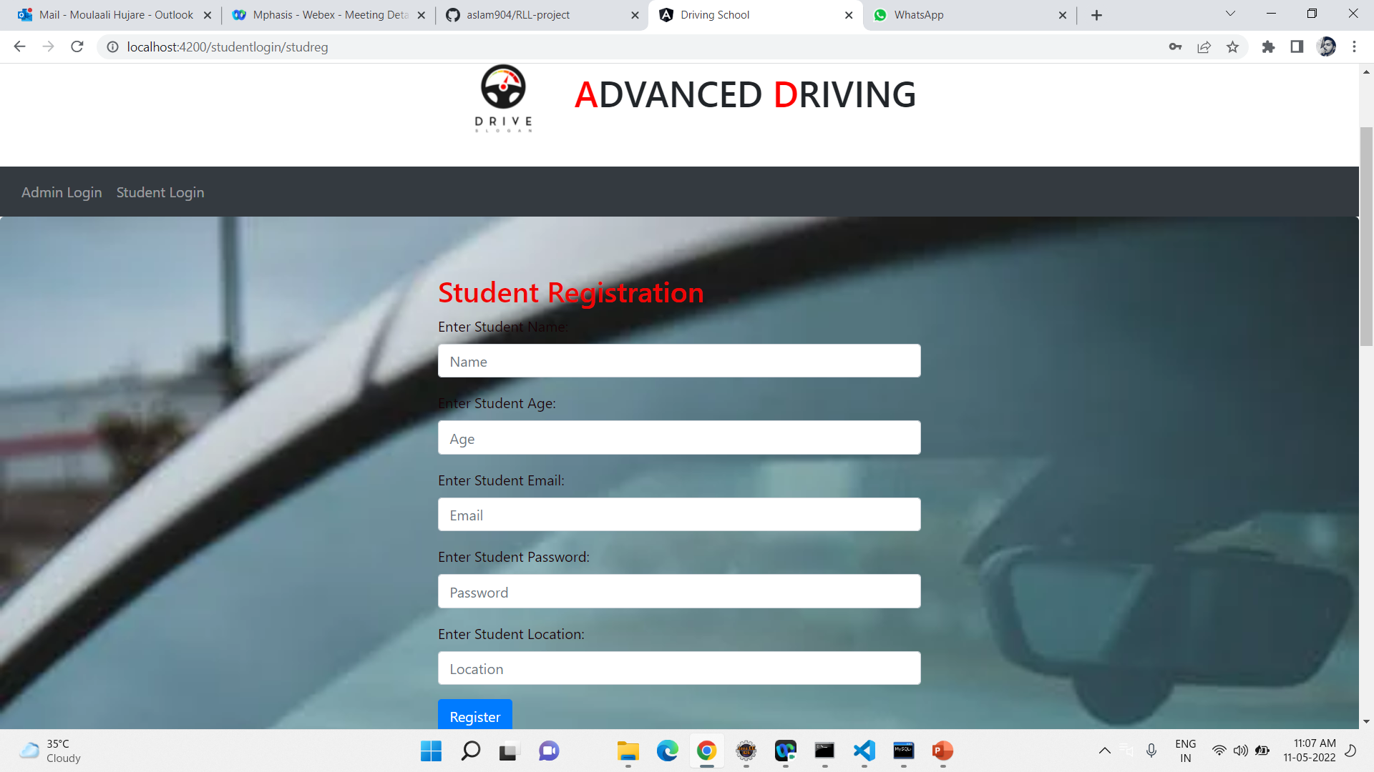
Student ReGISTRATION Page

Slide 17
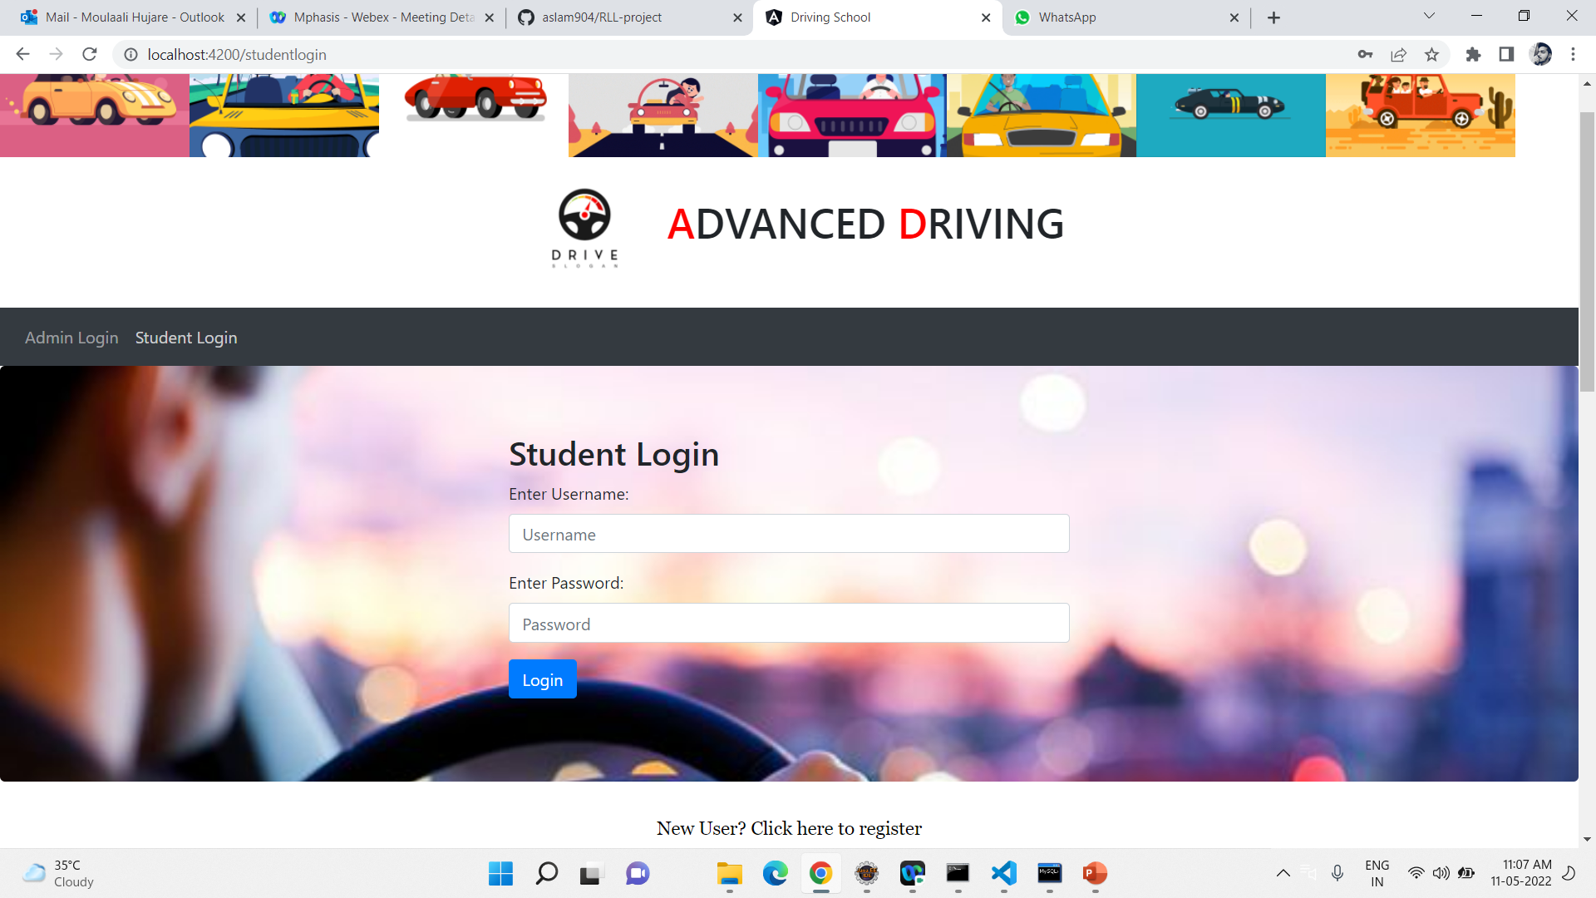
Student LOgin Page

Slide 18
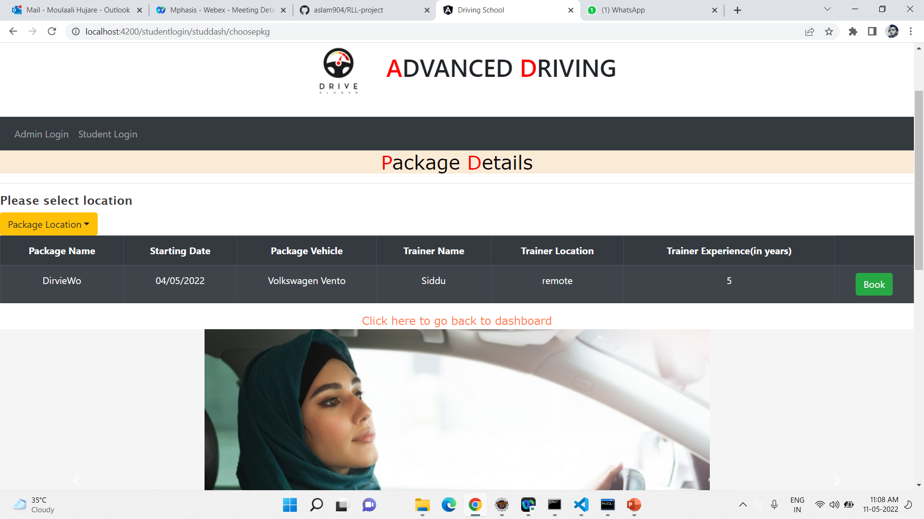
PACKAGE DETAILS

Slide 19
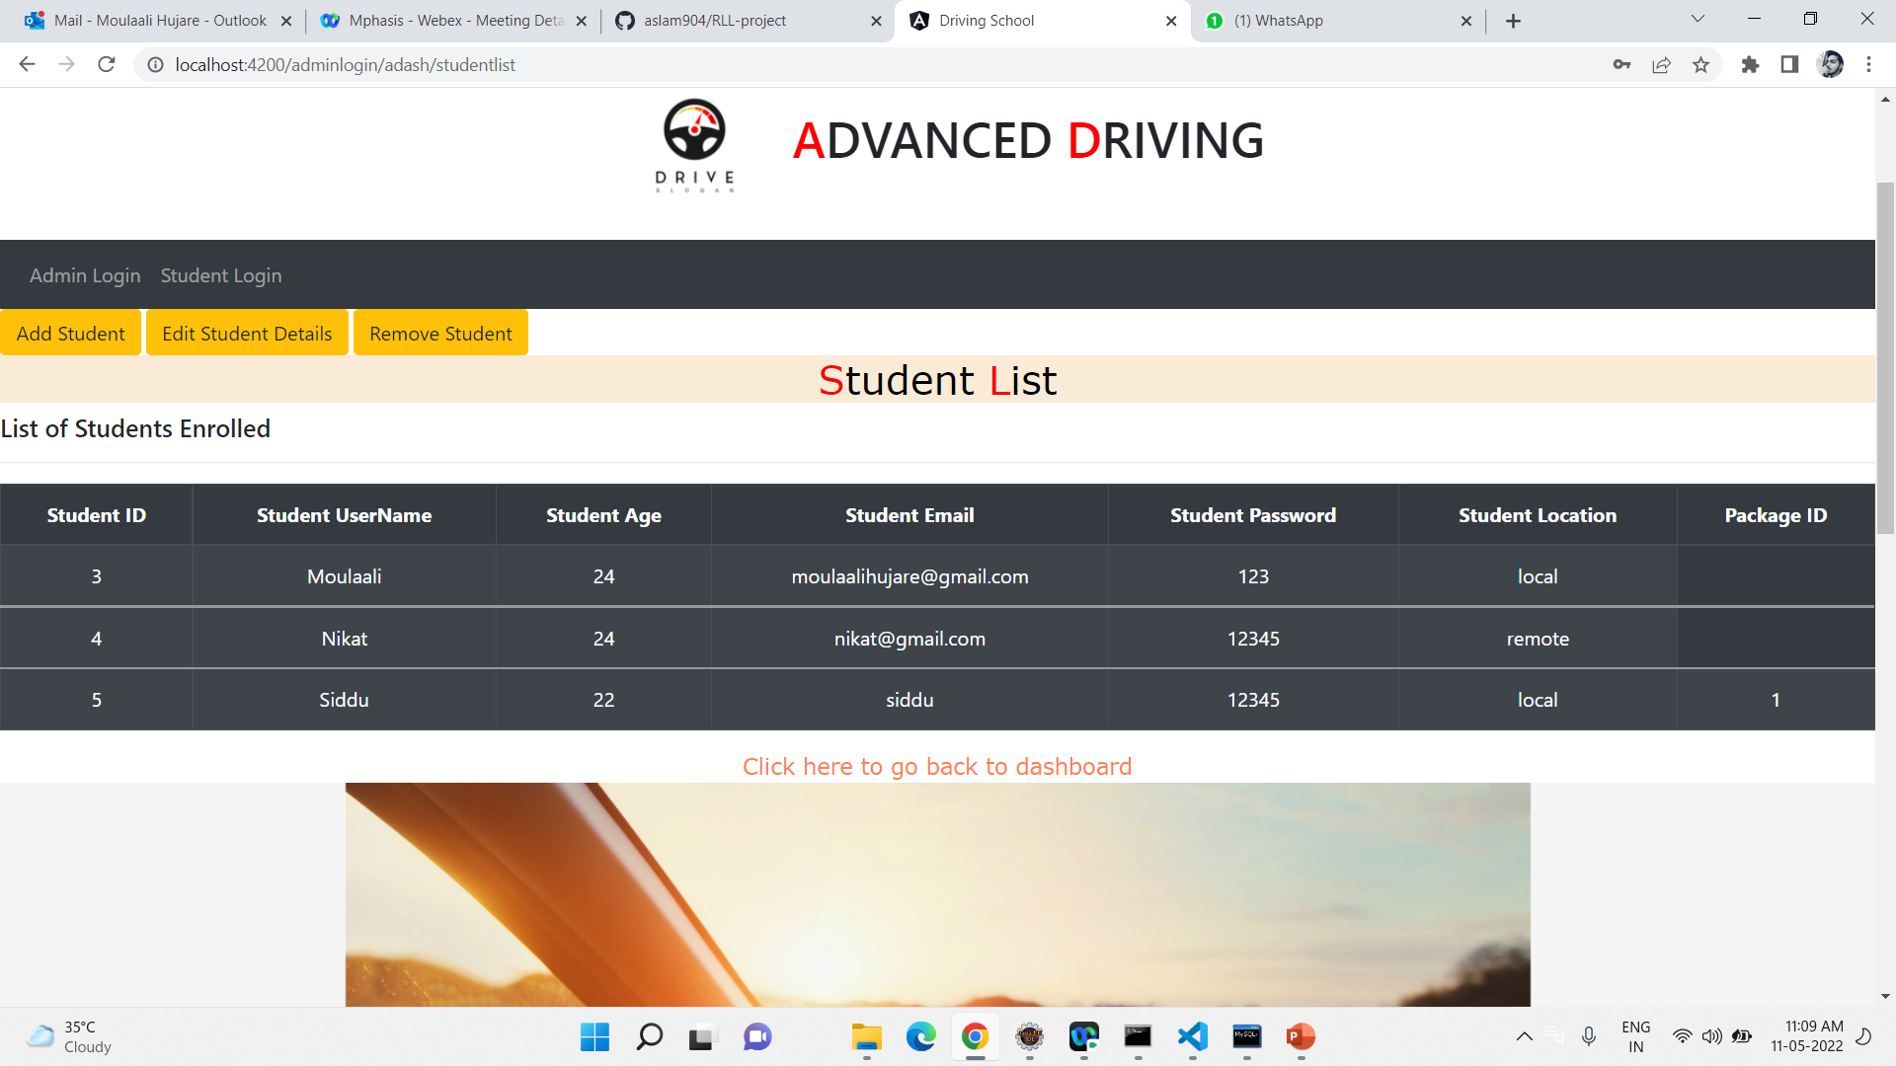
LIST OF STUDENTS ENROLLED

Slide 20
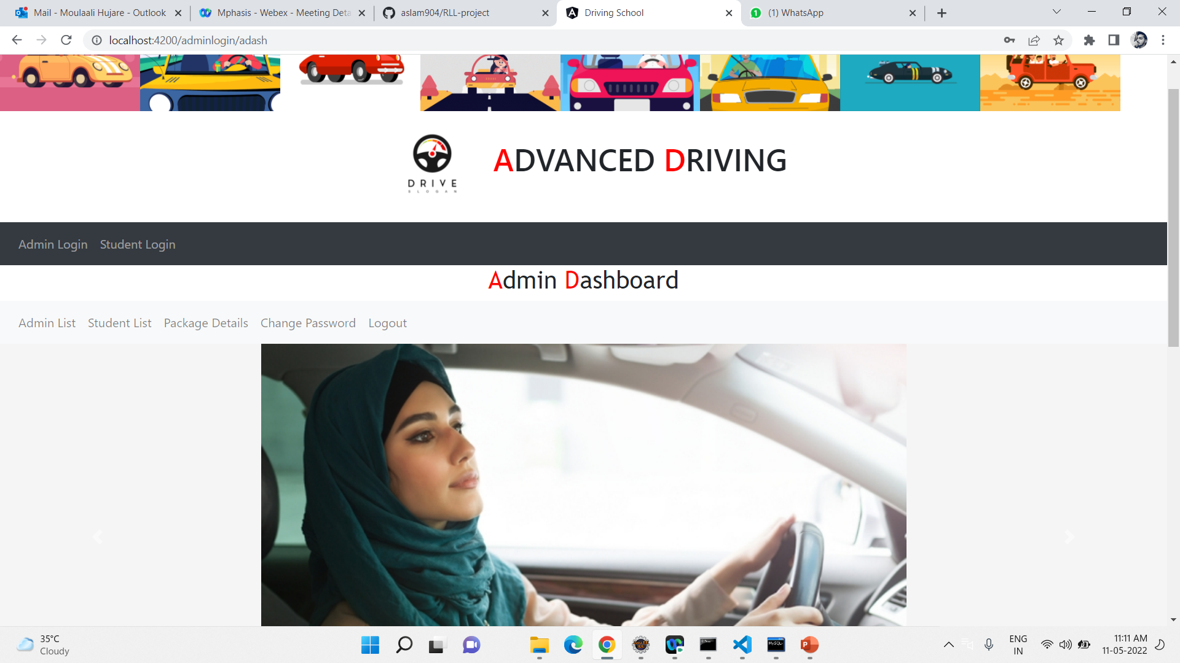
ADMIN DASHBOARD

Slide 21
CONCLUSION
This application automates manual tasks by managing all records of student’s admission, Attendance, vehicles,and trainers.
This Advanced Driving School Management system can reduce the efforts of human power.
This helps to increase business.

Slide 22
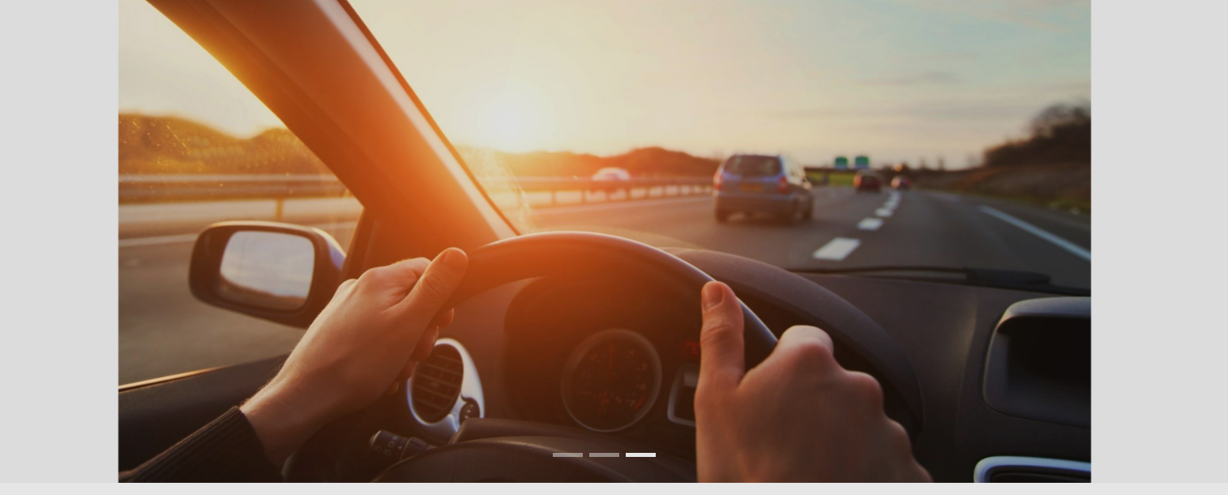
THANK YOU

